Slide 1
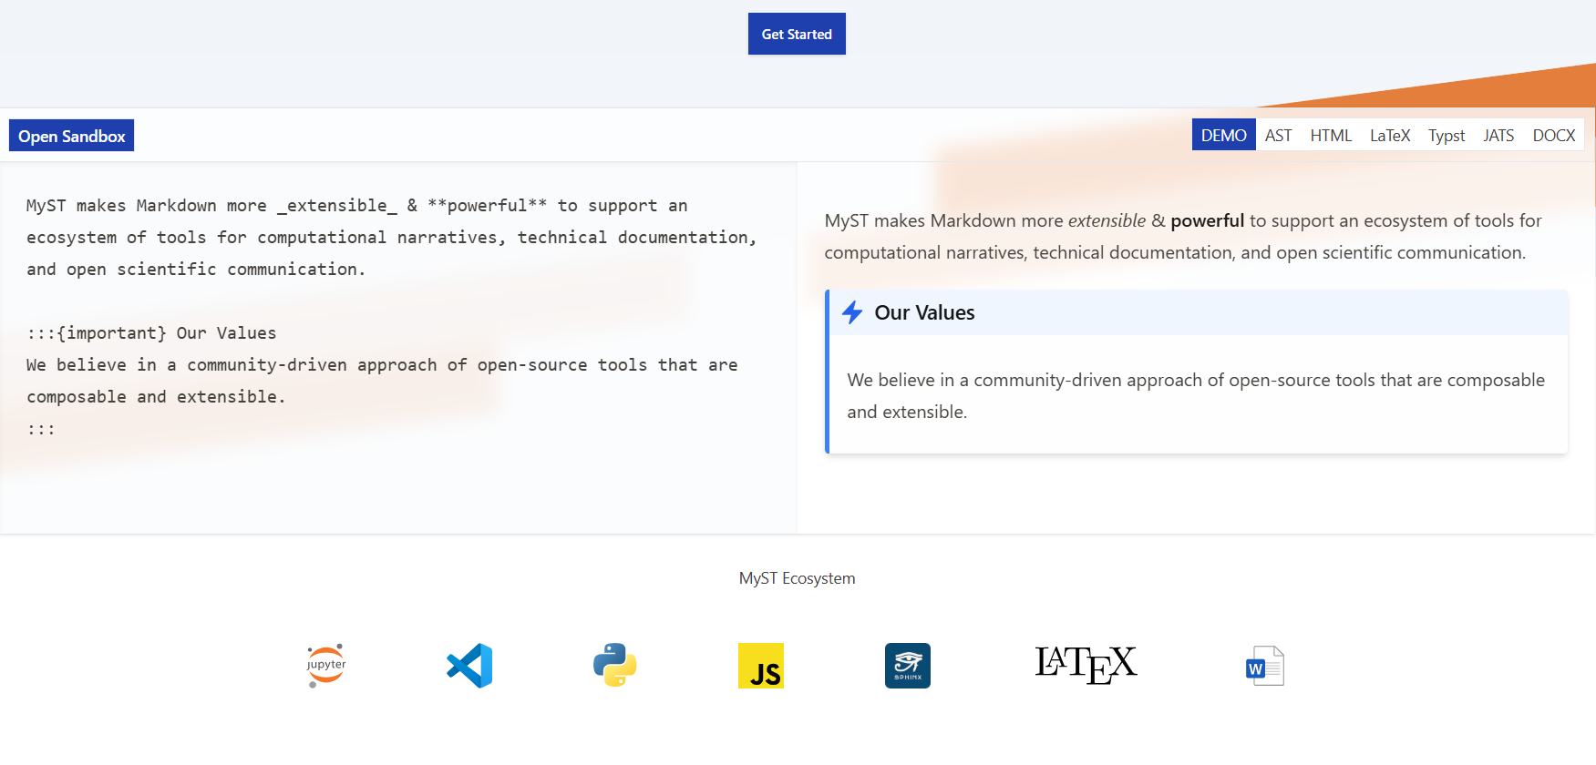
MyST & Jupyter Book 2 Community-driven tools for technical communication
Name…
Email…

Slide 2
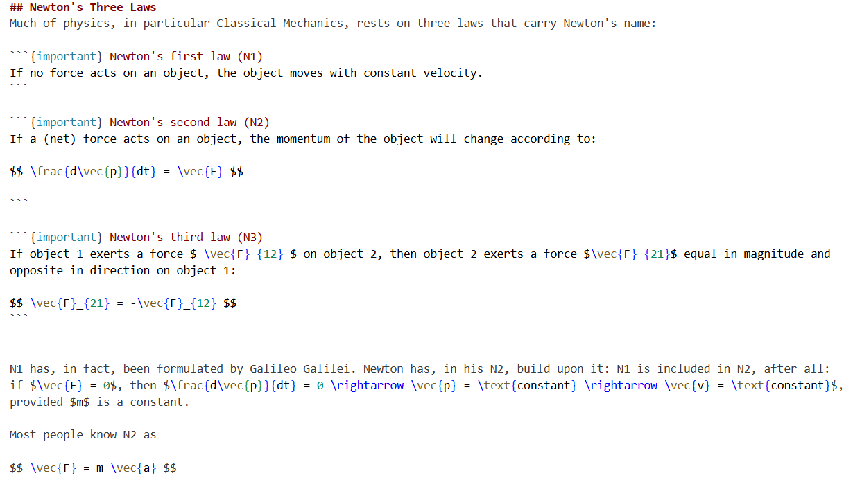
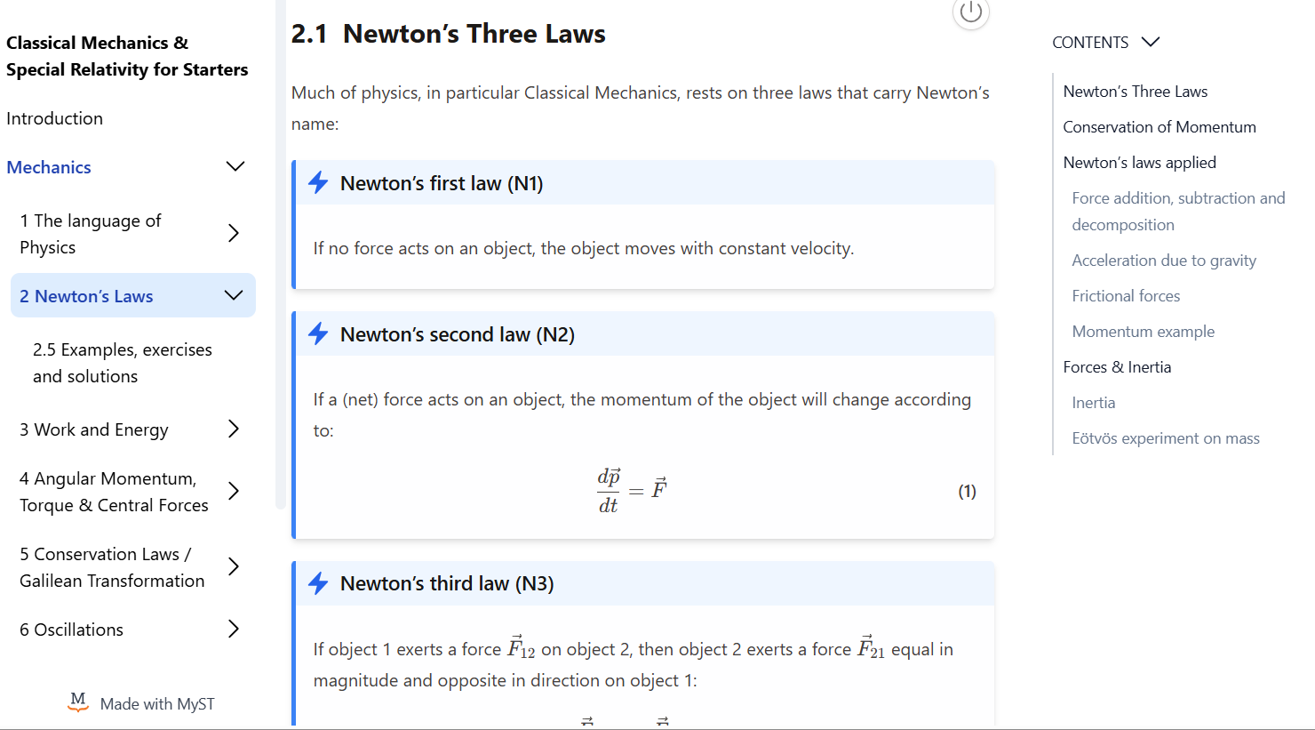
Jupyter Book project
The Jupyter Book project^{[1]} builds tools for authoring, reading, and publishing computational narratives.

Slide 3
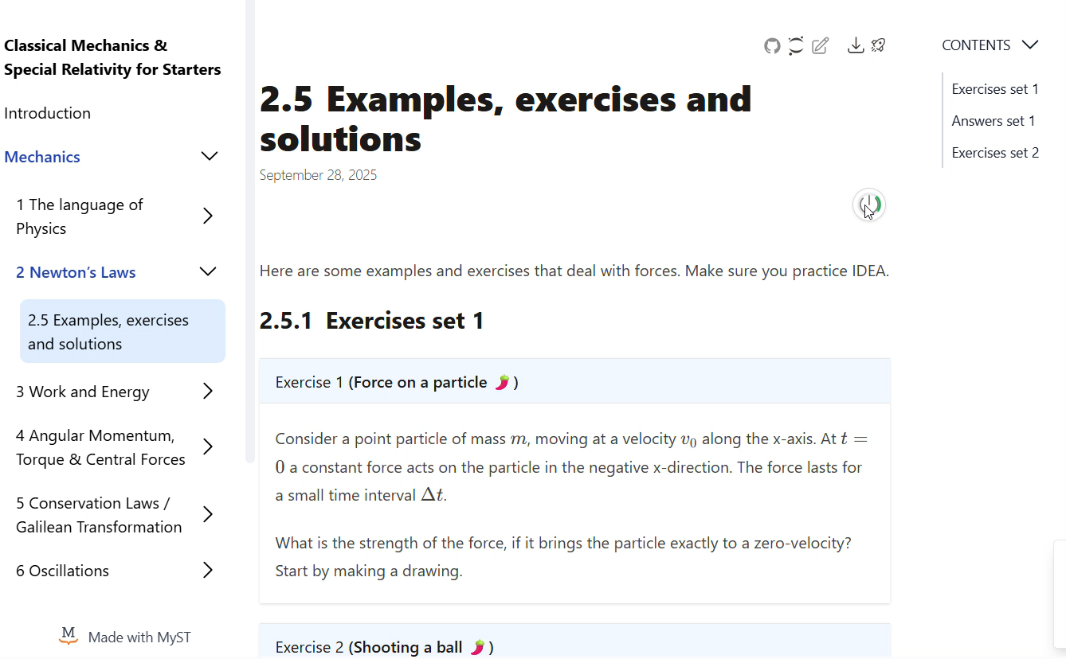
Jupyter Book project
Jupyter Book lets you create enriched and interactive multi-document computational narratives.

Slide 4
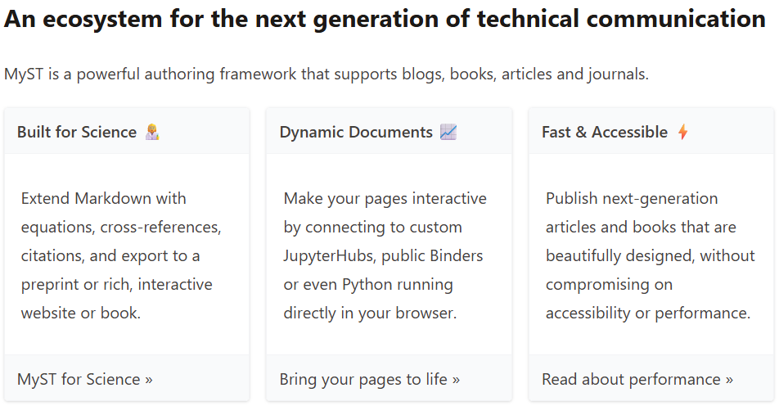
MyST
MyST extends Markdown for technical, scientific communication and publication.

Slide 5
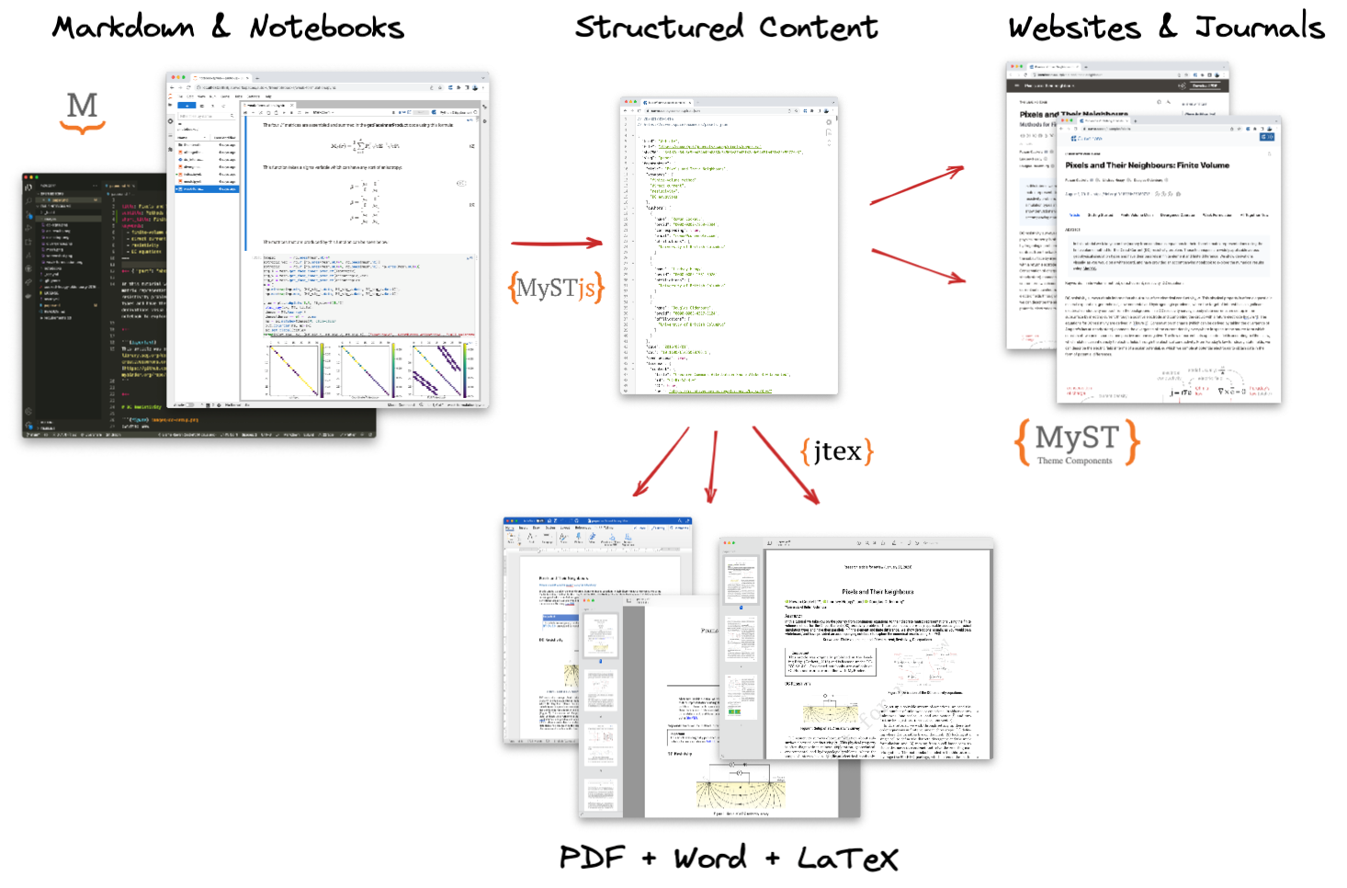
The power of MyST

Slide 6
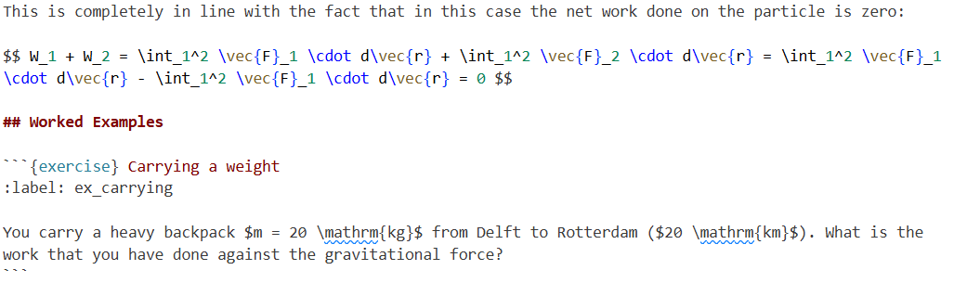
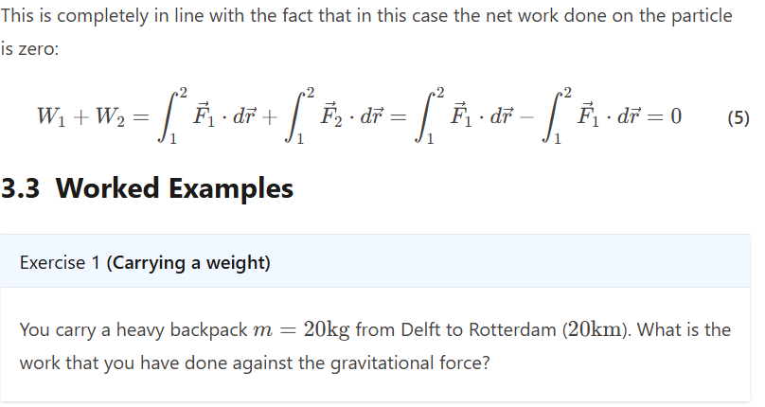
Markdown → Website → PDF

Slide 7


Markdown → Website → PDF

Slide 8
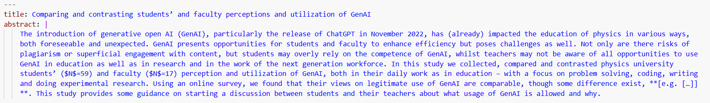
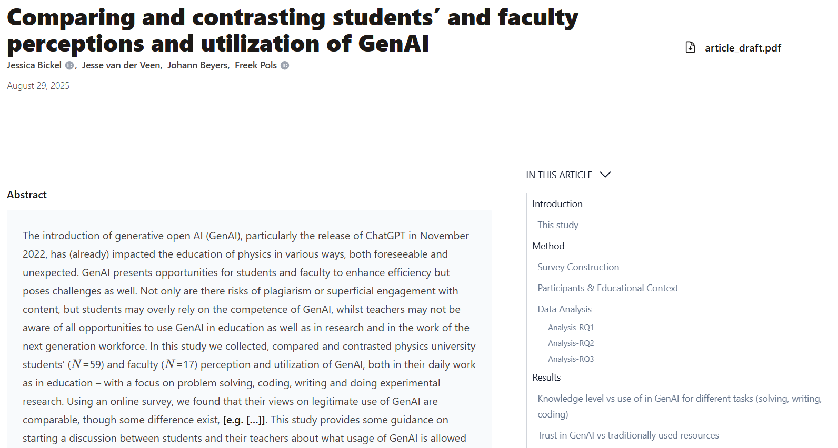

Markdown → Website → Article

Slide 9
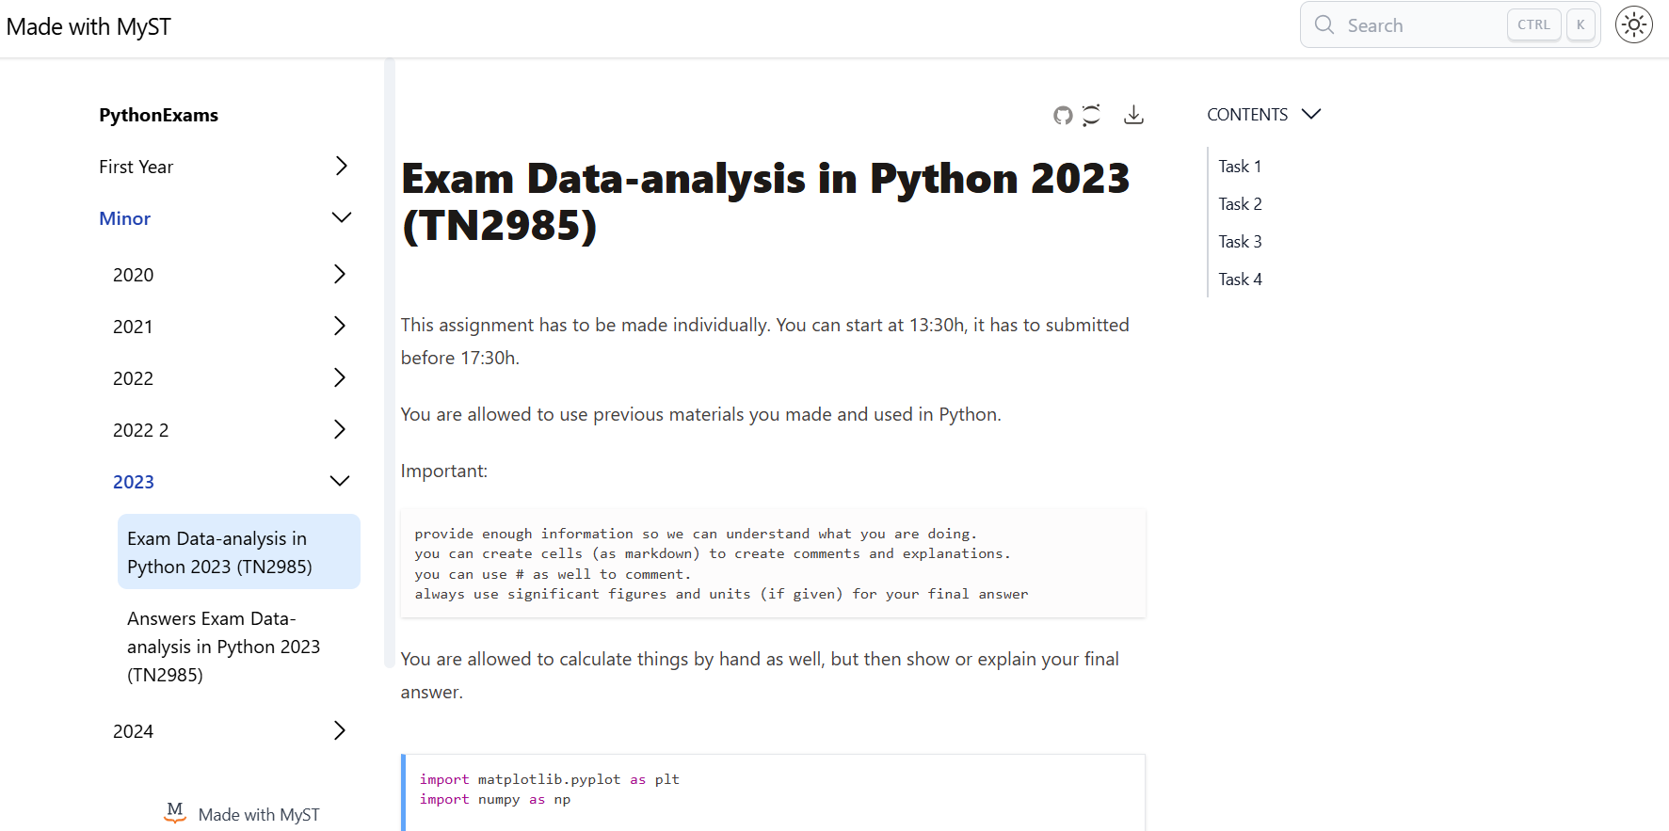
Making your projects findable / accessible

Slide 10
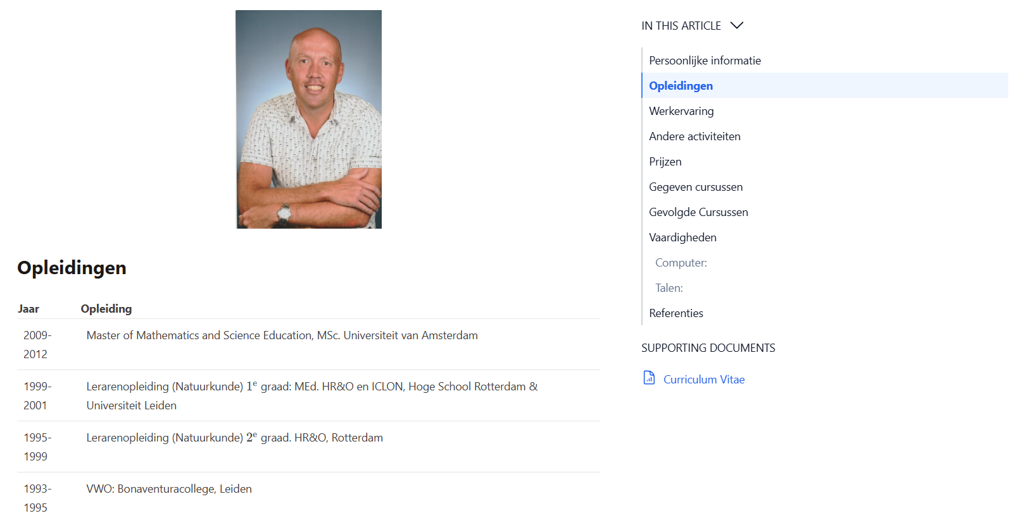
Build your CV

Slide 11
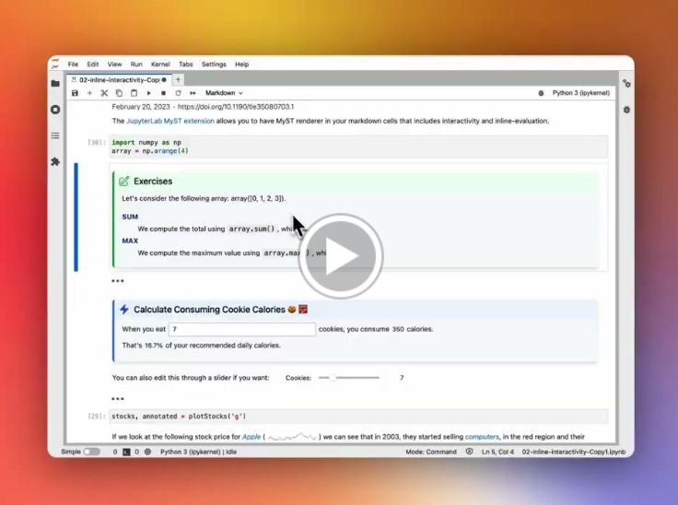
Jupyter-MyST

Slide 13
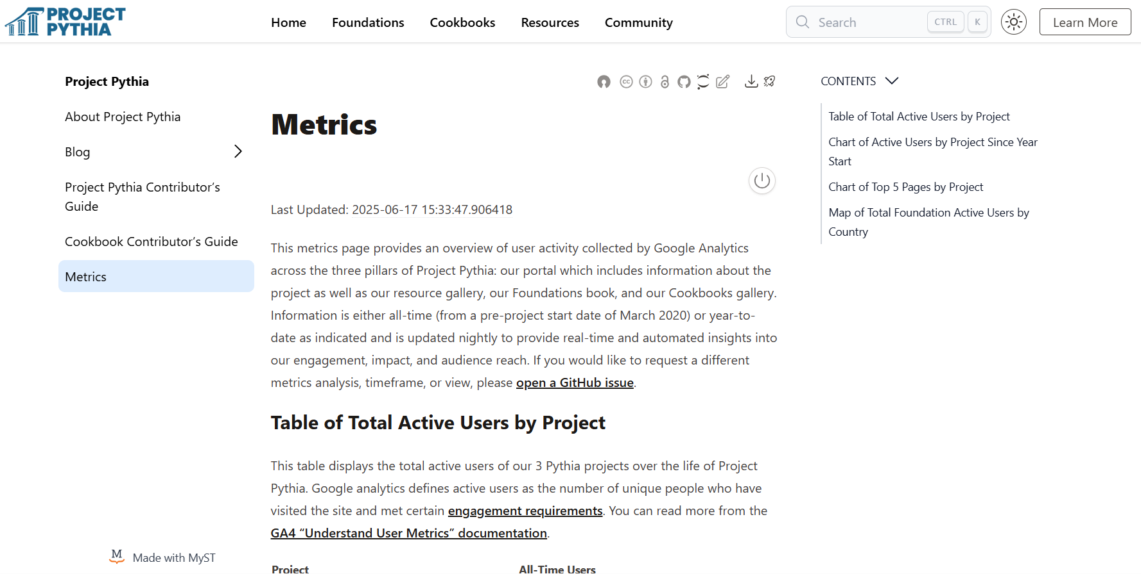
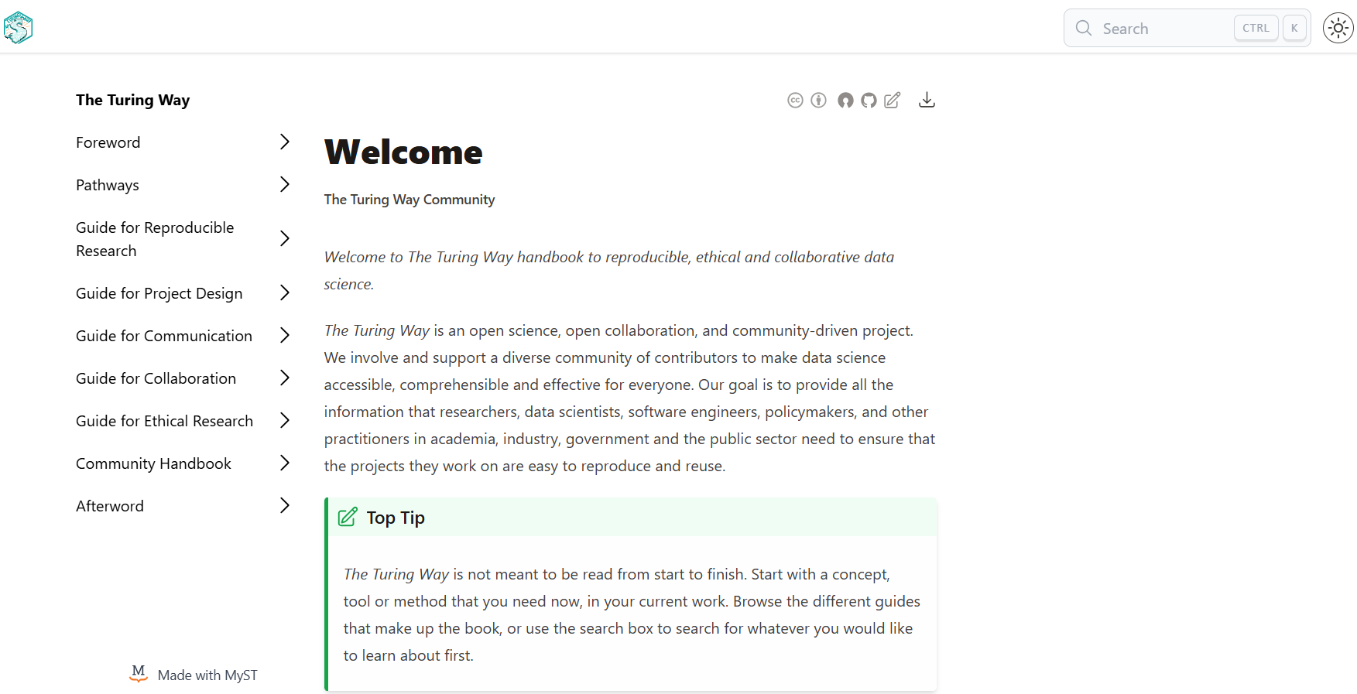
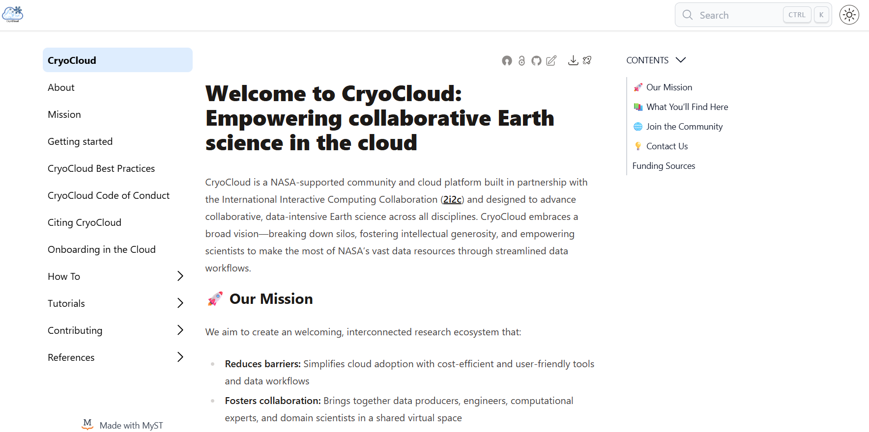
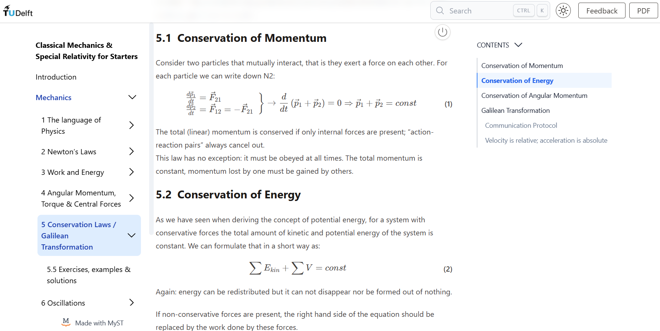
Gallery

Slide 15
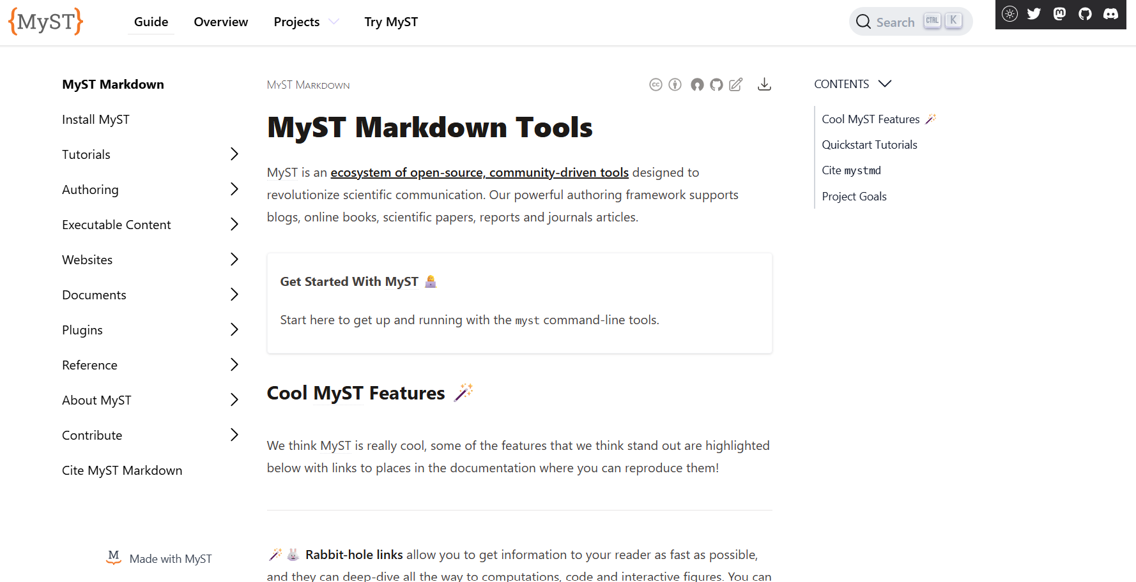
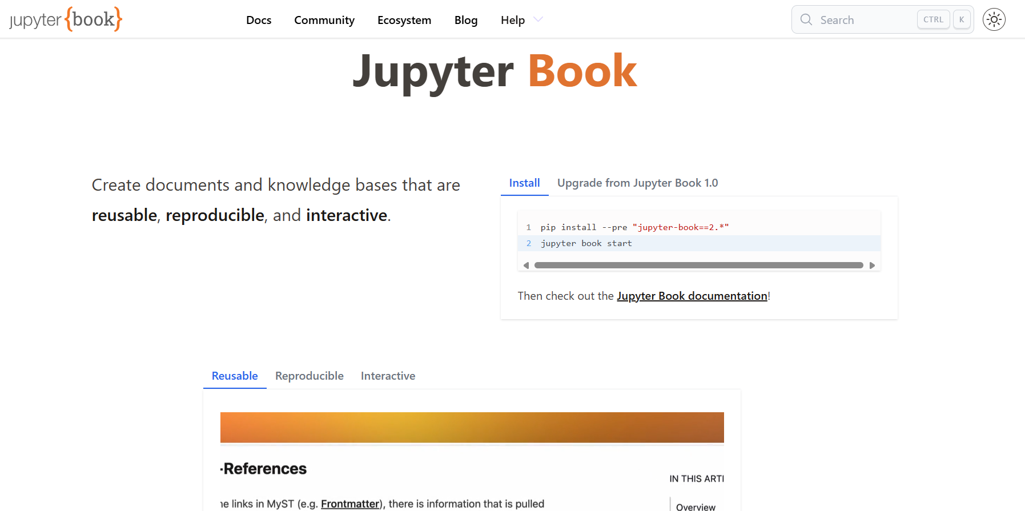
Where to start
mystmd.org/guide
MyST
Theme: Article
Jupyterbook.org
JB 2
Documentation
Theme: Book

Slide 16
Tutorial
github account
clone template
set up
GH pages
follow (steps from) tutorial
tutorial
advanced
start
install software
jupyter-book init
init local server
see official docs

Slide 18

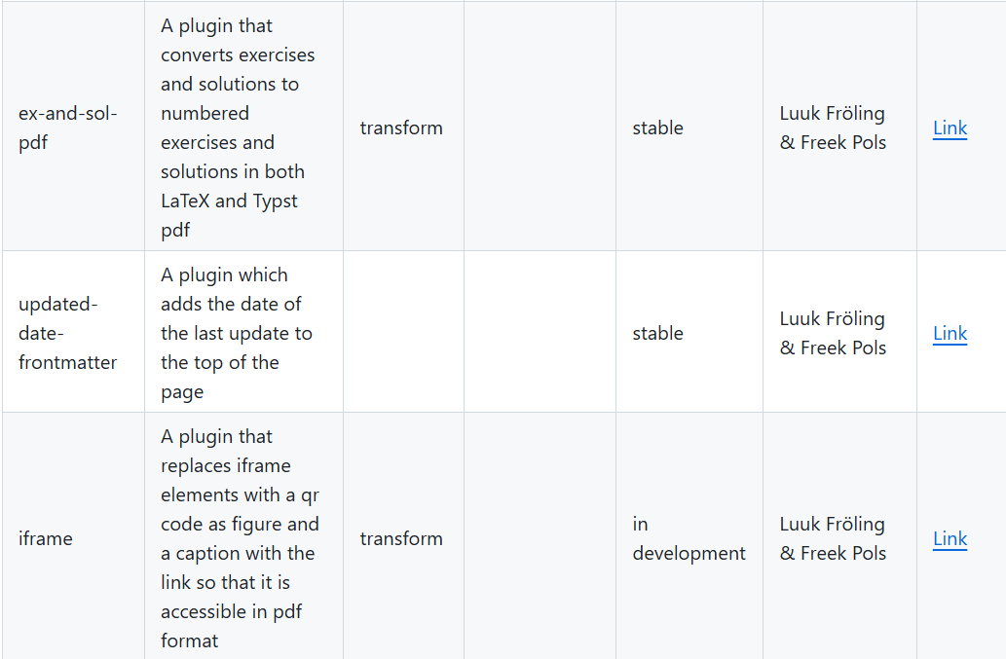
Plugins
https://github.com/jupyter-book/myst-plugins/

Slide 20
Acknowledgement
This presentation is based on
the MyST documentation
Chris Holdgraf’s Jupyter Book 2.0 and the MyST Engine presentation
[1]: https://jupyterbook.org/

